Slide 1


Regression Analysis of Opening Chess Moves
Elena Adame

Slide 2


Overview
The Variables
Probability Mass Function
Cumulative Distribution Function
Analytical Distribution
Scatterplots
Hypothesis Testing
Regression Analysis

Slide 3
The Variables
Dependent
Independent
Winner
Victory Status
Rated
White Rating
Black Rating
Opening Short Name

Slide 4
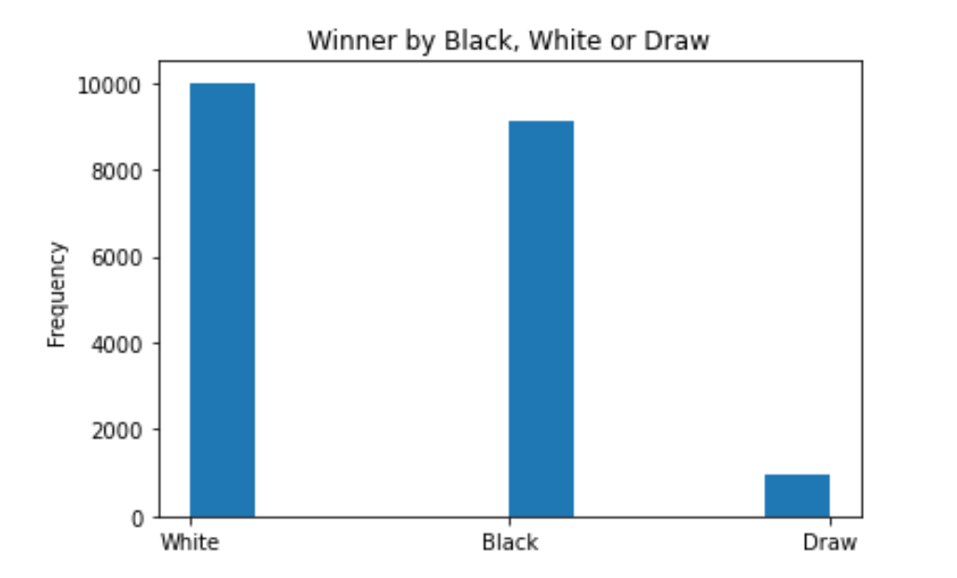
The Variable: Winner
This variable determines whether the player using black pieces or the play using white pieces won the game. In instances which resulted in draw, no winner is declared and draw is the output. In cases of resign, the player who did not withdraw is delcared the winner. In cases of out of time, the player currently in most advantage is delcared the winner.
Summary Statistics
Statistic | Value
Mean | *White
Mode | White
*Data based on Winner status with regard to the top five most used opening moves.

Slide 5
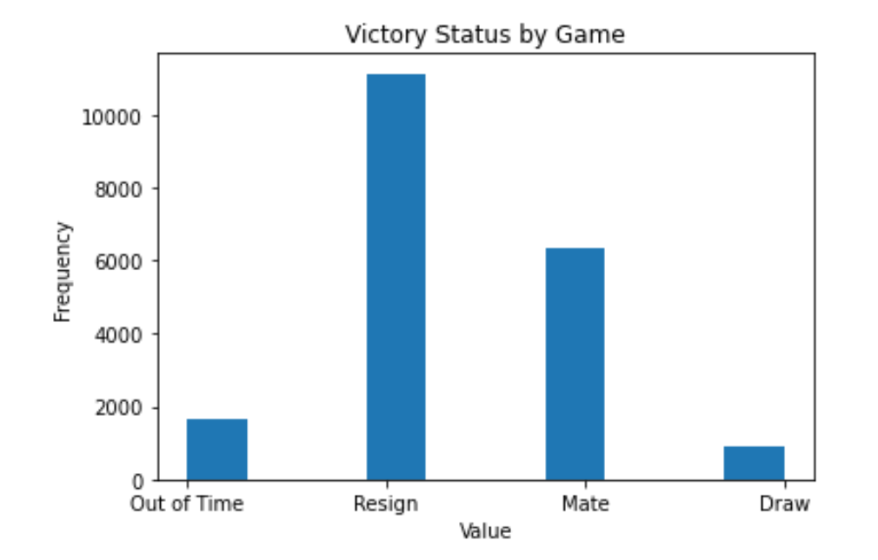
The Variable: Victory Status
This variable breaks down each game played into the four sub-variables:
Draw
Mate
Resign
Out of Time
Summary Statistics
Statistic | Value
Mean | N/A
Mode | Resign

Slide 6
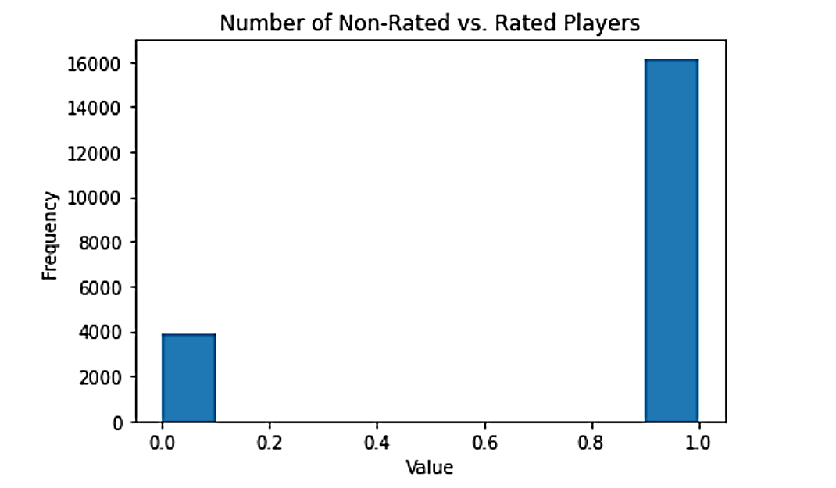
The Variable: Rated
This variable provides information on whether the chess player in the game is rated or not. A rated game is a game that chess.com, from which the data came, is considered an official game. An official game is used to determine the player's chess rating based on the outcome of the player's game.
Summary Statistics
Statistic | Value
Mean | Rated
Mode | Rated
Spread | 0.157

Slide 7
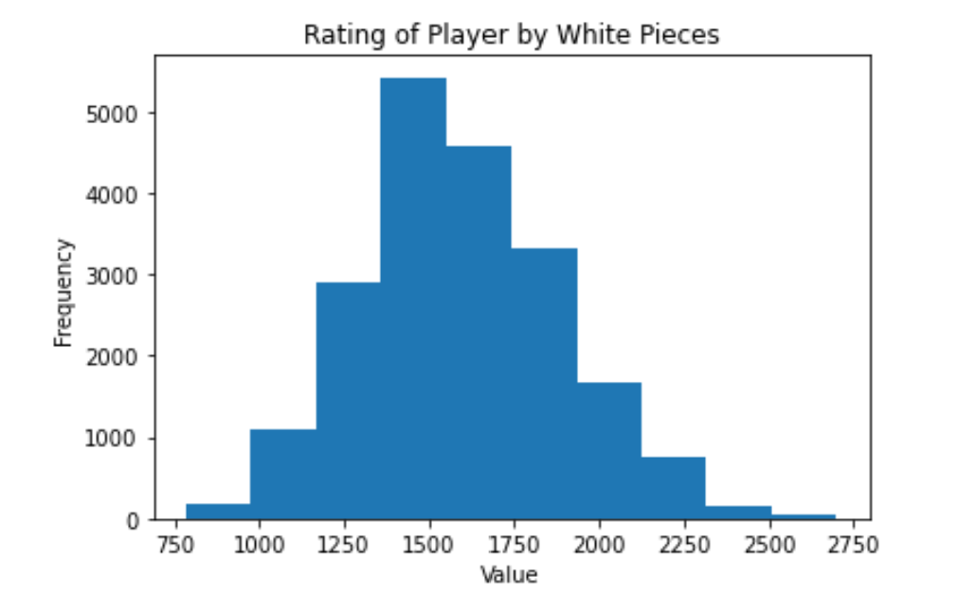
The Variable: White Rating
This variable provides the rating of the player using the white pieces. The rating scale for the chess system begins at "below 1200" to "2700+", with novices being under 1200 and World Championship Contenders having a rating of 2700+.
Summary Statistics
Statistic | Value
Mean | 1596.63
Std | 291.25
Mode | 1500
Spread | 84828.53

Slide 8
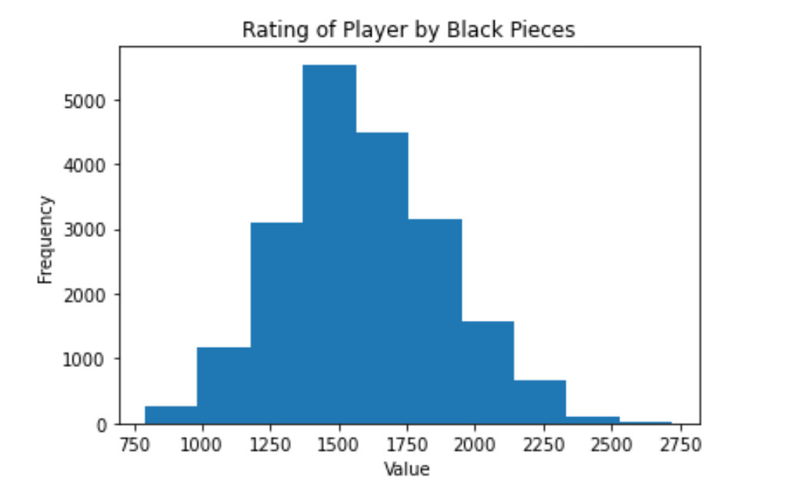
The Variable: Black Rating
This variable provides the rating of the player using the black pieces. The rating scale for the chess system begins at "below 1200" to "2700+", with novices being under 1200 and World Championship Contenders having a rating of 2700+.
Summary Statistics
Statistic | Value
Mean | 1588.83
Std | 291.04
Mode | 1500
Spread | 847702.03

Slide 9
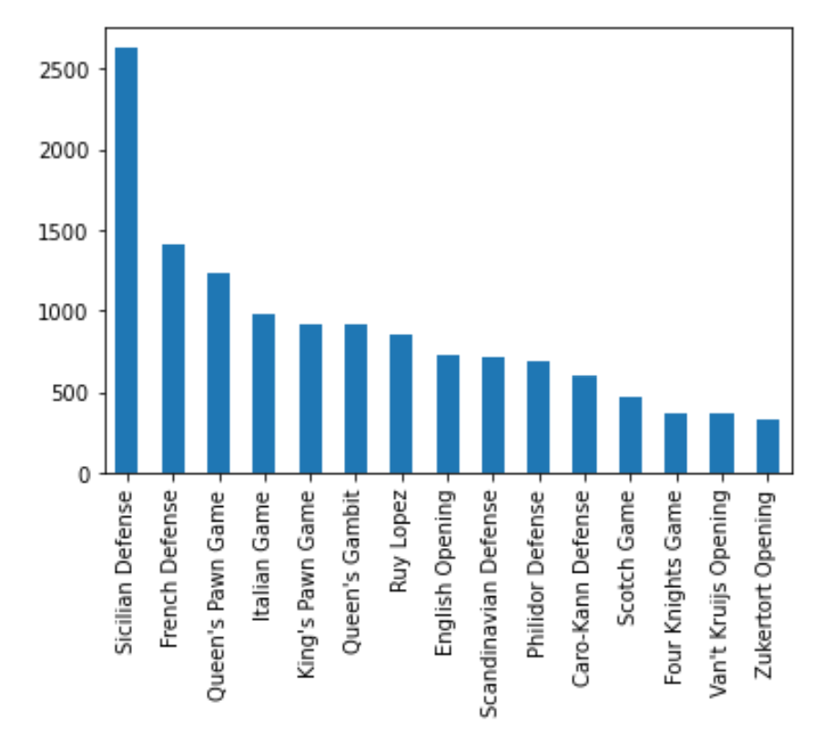
The Variable: Opening Short Name
This variable lists out the various openings used by the starting chess player for each game.
Summary Statistics
Statistic | Value
Mean | *Italian Game
Mode | Sicilian Defense
*Data based the top five most used opening moves.

Slide 10
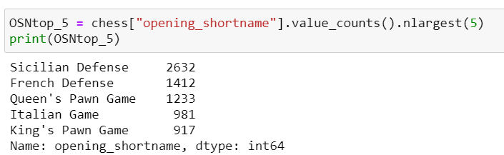
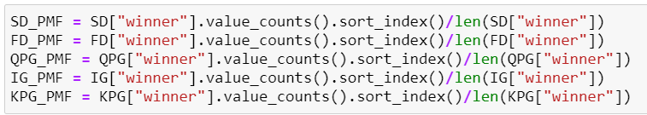
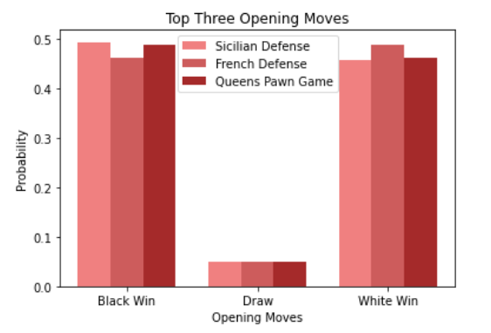
Probability Mass Function (PMF) Creation
Below is the ouput of the top three most used chess openings. Only three of the openings were used as the graph was unable to support a higher number while maintaining a readable format.
All opening moves listed in the legend below were made by white, the aim for this project was to determine whether opening moves affected the overall outcome of the game.
Above is the code utilized to narrow the variable “opening_shortname” into the top five most used chess openings. PMFs for each of the top five were created.
PMFs for all of the openings made and captured for this dataset was unable to be made. Further analysis would include analyzing the difference in between the least chosen opening moves.

Slide 11
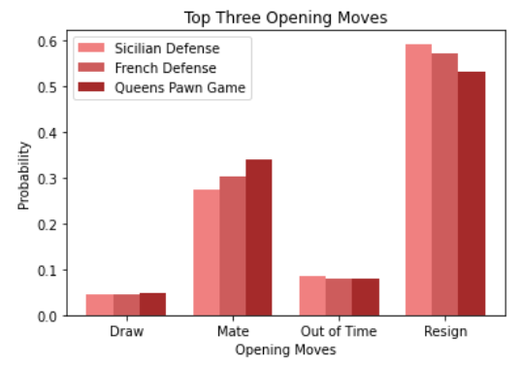
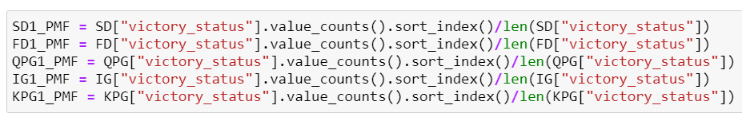
PMF Creation Cont.
To the right is the ouput of the PMF according to the “victory_status” variable within the dataset. A quick trend noticed was for the “Resign” outcome. This showed that as the usage of the openings decreased, the game in which these moves were used ultimately resulted in a Resign. The relationship between the Resign outcome and the Winner outcome has not been explored during this project. Further analysis would include determining whether the usage of the moves with regard to the Resign status resulted in winning or losing.

Slide 12
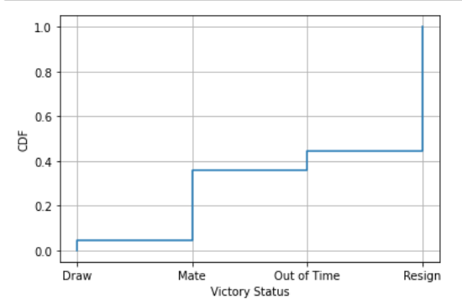
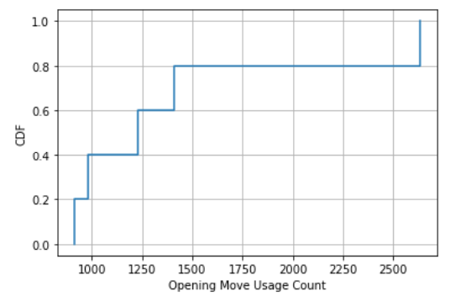
Cumulative Distribution Function (CDF)
Above are the CDFs created using the ‘victory_status’ and ‘opening_shortname’ variables. The CDF created for the ‘opening_shortname’ variable was created using only the top five variables. The code refused to label the CDF for ‘opening_shortname’.

Slide 13
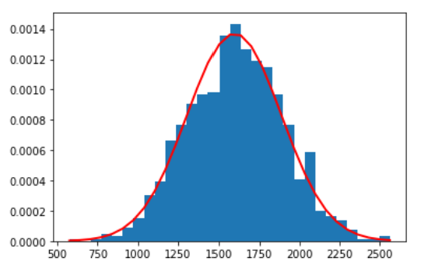
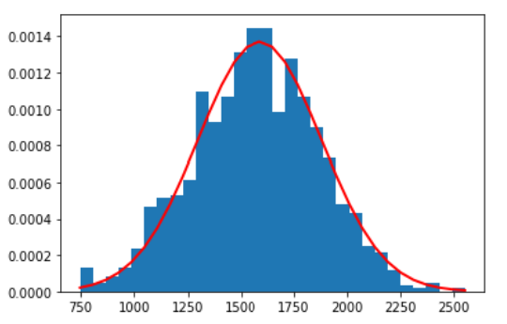
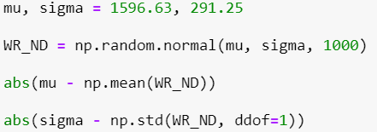
Analytical Distribution
The Normal Distribution to the left represents the distribution of the White Rating and the graph to the right represents the Black Rating. The code used to produce these two graphs can be seen on the left. I performed the analyzation distribution on these two variables to determine how evenly matched the players were. Based on the graphs, players using the white pieces had a higher rating on average than those using the black pieces. A higher portion of the ratings for White fall to the right of 1600 while black appears more evenly distributed.

Slide 14
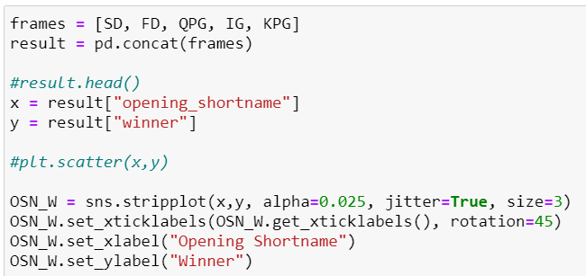
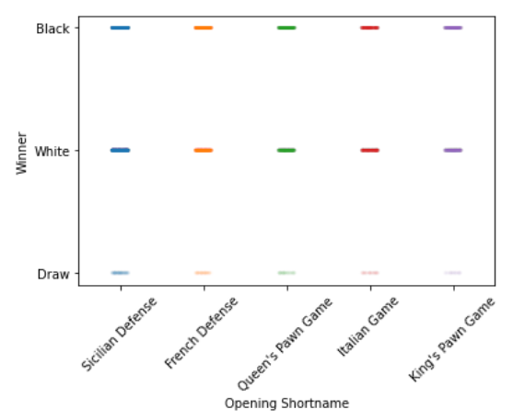
Scatterplot: Opening Shortname vs. Winner
To the right is a scatterplot created utilizing the Opening Shortname and Winner variables. This was done using the data for only the top five most used opening moves. When initially created, the data displayed as single points. The transparency and jitter of the data was adjusted in order to gain more insight. The lightness of the data at the draw line leads to the conclusion that not many of the games begun with these five moves ended in draw, at least with respect ot the other two options. White appears to have thicker lines than black, leading to the conclusion that white edged out in winning using these opening moves.
Correlation | Value
Spearman | 0.011
Pearson | 0.006

Slide 15
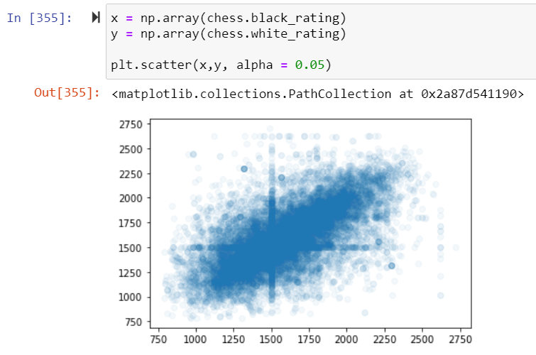
Scatterplot: White Rating vs. Black Rating
Here I made a scatterplot of the White Rating vs. the Black Rating. Due to the number of data points, the graph ended up being overplotted. To compensate, I adjusted the transparency of the data. A cross centered at x = 1500 and y =1500 can be seen within the graph. It is unclear what statistical note can be taken from that.
Both Spearman and Pearson’s correlation was determined. Both values were within 0.02 of the other. The values showed that if there is a correlation between White Rating and Black Rating, it is to weak to be significant.
Correlation | Value
Spearman | 0.654
Pearson | 0.634

Slide 16
Hypothesis Testing
Black Rating vs. White Rating
The test performed for these two variables was the two-tailed test. This test was chosen as the two variables are both independent of the other. The p-value provided was 0.007, which is less than 0.05. This leads to the rejection of the null hypothesis.
Winner vs. Opening Shortname
The T test within scipy.stats was chosen to test these two variables. This test provide a p-value of 0.0. At this time, it is unknown there is statistical significance between the two variables. The values of both Pearson and Spearmn’s for the scatterplot showed there was a very weak correlation between the two variables; too weak to be significant.

Slide 17
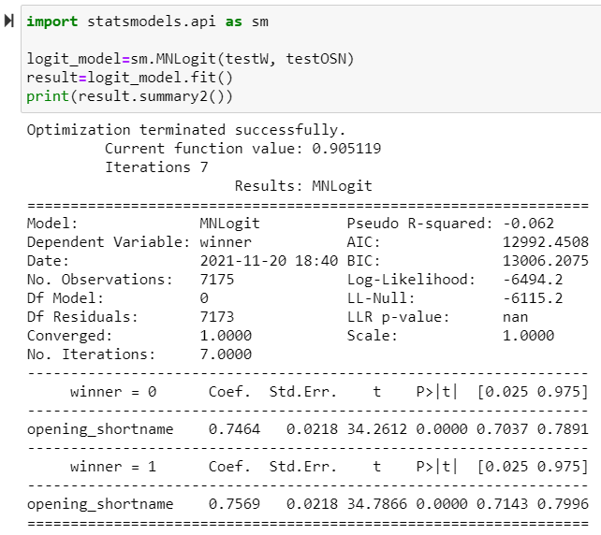
Regression Analysis
For this project, I created a Multinomial Logistic Regression as the two variables used, Opening Shortname and Winner, were a independent and dependent variable, respectively.
The p-value calculated from this regression was 0.00, which is less than 0.05. I can now conclude that the relationship between the two variables is statistically significant and that the opening moves in a chess game do play some part in the outcome of the game. To what degree still needs investigation.

